Slide 1

Lecture 16-18
Database Design and the E-R Model

Slide 2
Outline
Extended E-R Features
Entity-Relationship Design Issues

Slide 3
Practice 01
Construct an E-R diagram for a car insurance company whose customers own one or more cars each. Each car has associated with it zero to any number of recorded accidents. Each insurance policy covers one or more cars, and has one or more premium payments associated with it. Each payment is for a particular period of time, and has an associated due date, and the date when the payment was received.

Slide 4
Extended ER Features

Slide 5
Enhanced Entity-Relationship Model
Since 1980s there has been an increase in emergence of new database applications with more demanding requirements.
Basic concepts of ER modeling are not sufficient to represent requirements of newer, more complex applications.
Semantic concepts are incorporated into the original ER model and called the Enhanced Entity-Relationship (EER) model.
Examples of additional concept of EER model is called specialization / generalization.
Pearson Education © 2009

Slide 6
Specialization / Generalization
Superclass
An entity type that includes one or more distinct subgroupings of its occurrences.
Subclass
A distinct subgrouping of occurrences of an entity type.
Pearson Education © 2009

Slide 7
Specialization / Generalization
Superclass/subclass relationship is one-to-one (1:1).
Superclass may contain overlapping or distinct subclasses.
Not all members of a superclass need be a member of a subclass.
Pearson Education © 2009
Notes:
a member of staff who is both a Manager and a member of Sales Personnel. In this example, Manager and SalesPersonnel are overlapping subclasses of the Staff
superclass.
On the other hand, not every member of a superclass need be a member of a subclass; for example, members of staff without a distinct job role such as a Manager or a
member of Sales Personnel.

Slide 8
Specialization / Generalization
Attribute Inheritance
An entity in a subclass represents same ‘real world’ object as in superclass, and may possess subclass-specific attributes, as well as those associated with the superclass.
Pearson Education © 2009

Slide 9
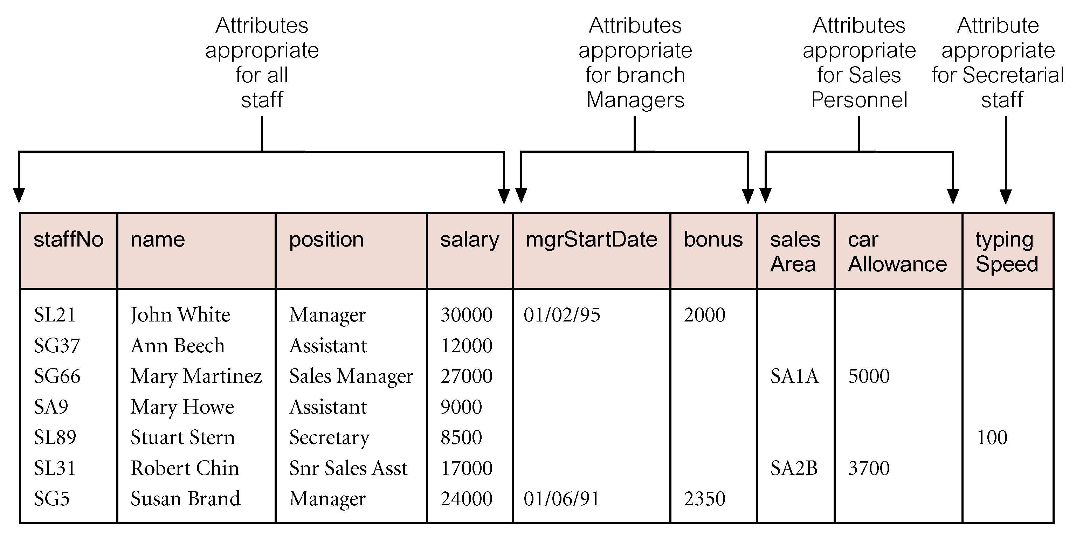
All Staff relation holding details of all staff
Pearson Education © 2009

Slide 10
Specialization / Generalization
Specialization
Process of maximizing differences between members of an entity by identifying their distinguishing characteristics.
Generalization
Process of minimizing differences between entities by identifying their common characteristics.
Pearson Education © 2009

Slide 11
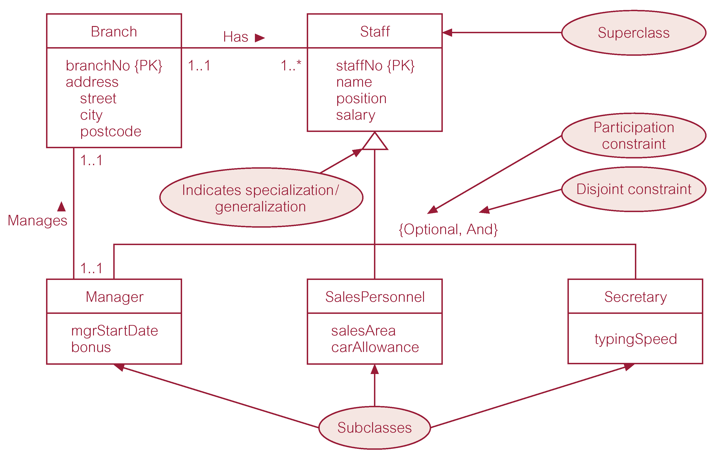
Specialization/generalization of Staff entity into subclasses representing job roles
Pearson Education © 2009

Slide 12
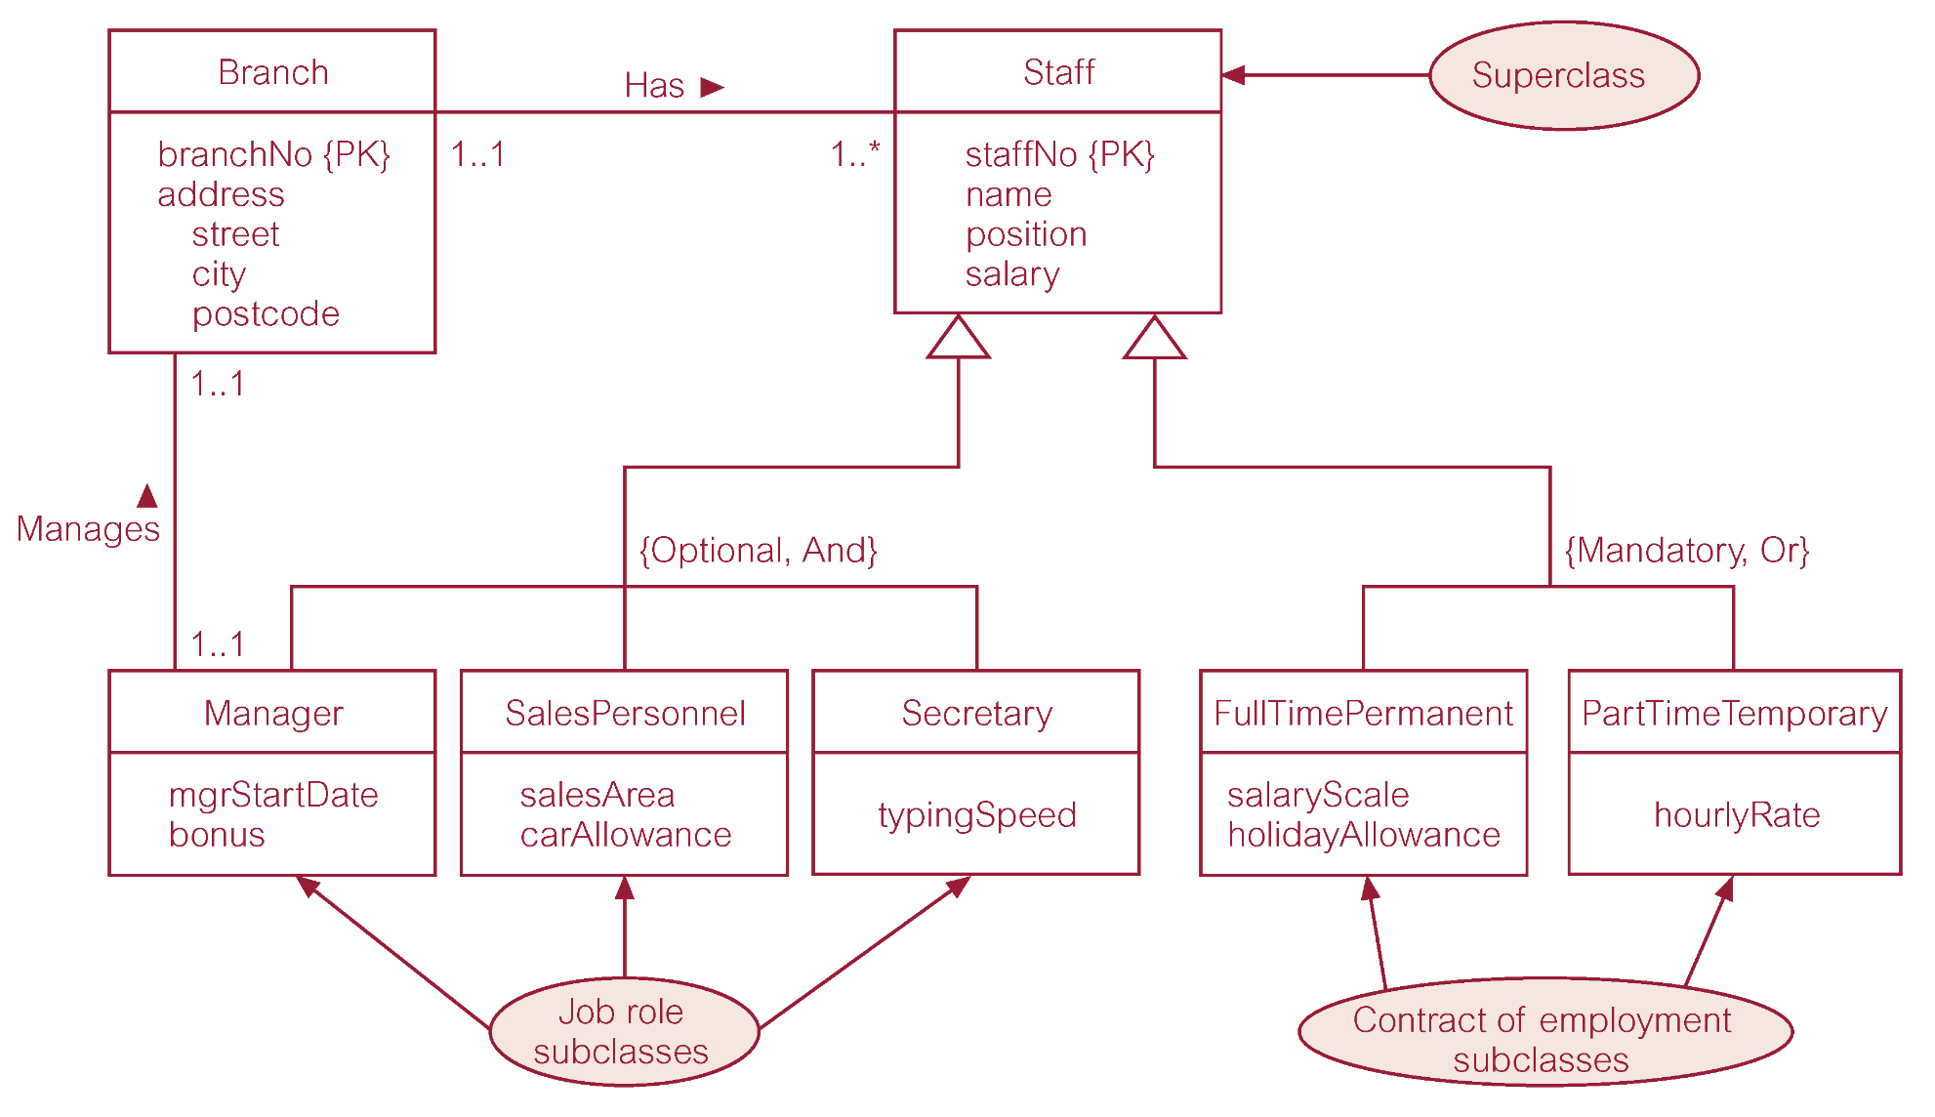
Specialization/generalization of Staff entity into job roles and contracts of employment
Pearson Education © 2009

Slide 13
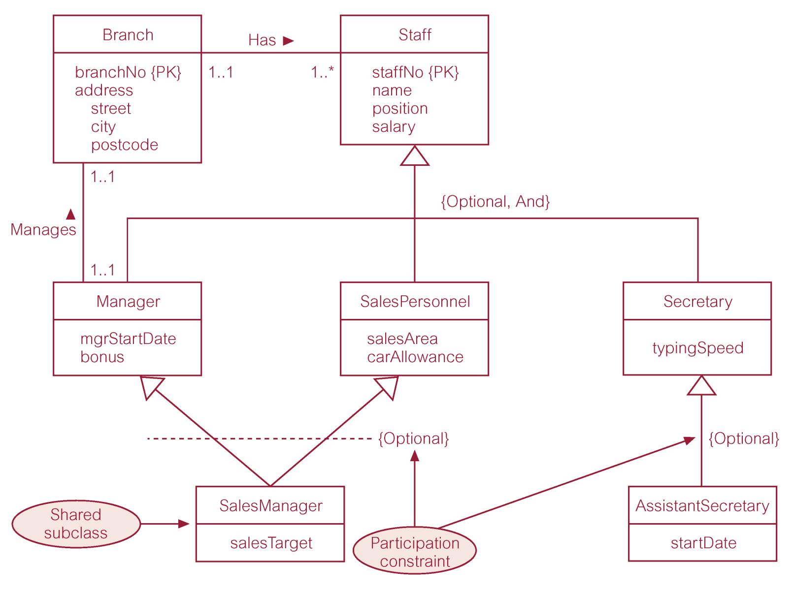
EER diagram with shared subclass and subclass with its own subclass
Pearson Education © 2009

Slide 14
Constraints on Specialization / Generalization
Two constraints that may apply to a specialization/generalization:
Participation constraint
Determines whether every member in superclass must participate as a member of a subclass.
May be mandatory or optional.
Disjoint constraint
Describes relationship between members of the subclasses and indicates whether member of a superclass can be a member of one, or more than one, subclass.
May be disjoint (OR) or nondisjoint (AND).
Pearson Education © 2009

Slide 15
Constraints on Specialization / Generalization
There are four categories of constraints of specialization and generalization:
optional and disjoint
mandatory and disjoint
mandatory and nondisjoint
optional and nondisjoint.
Pearson Education © 2009

Slide 16
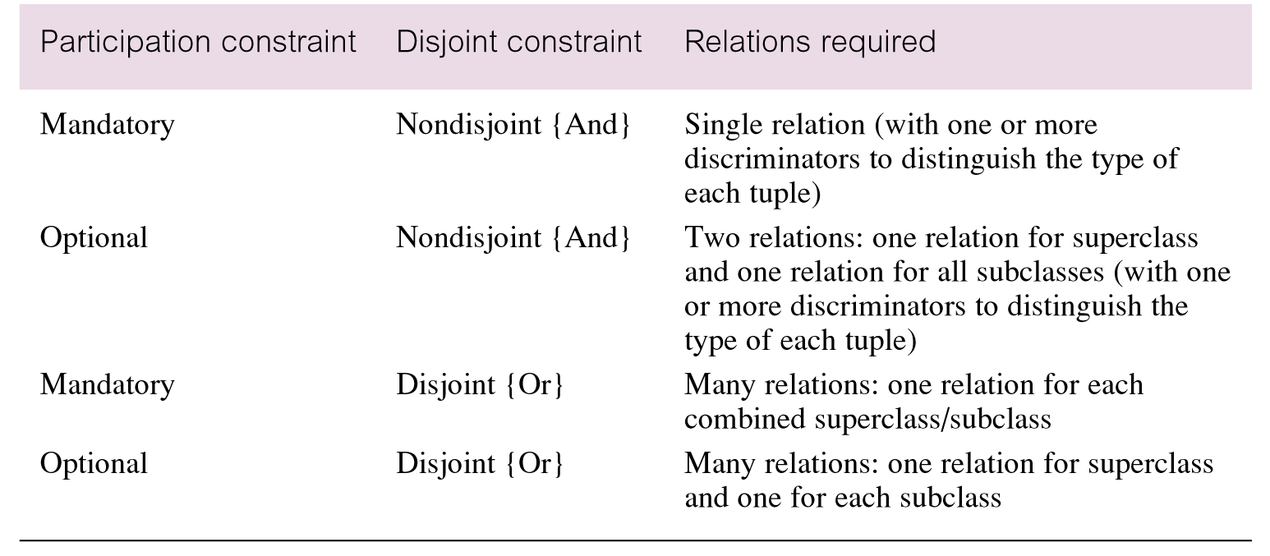

Slide 17
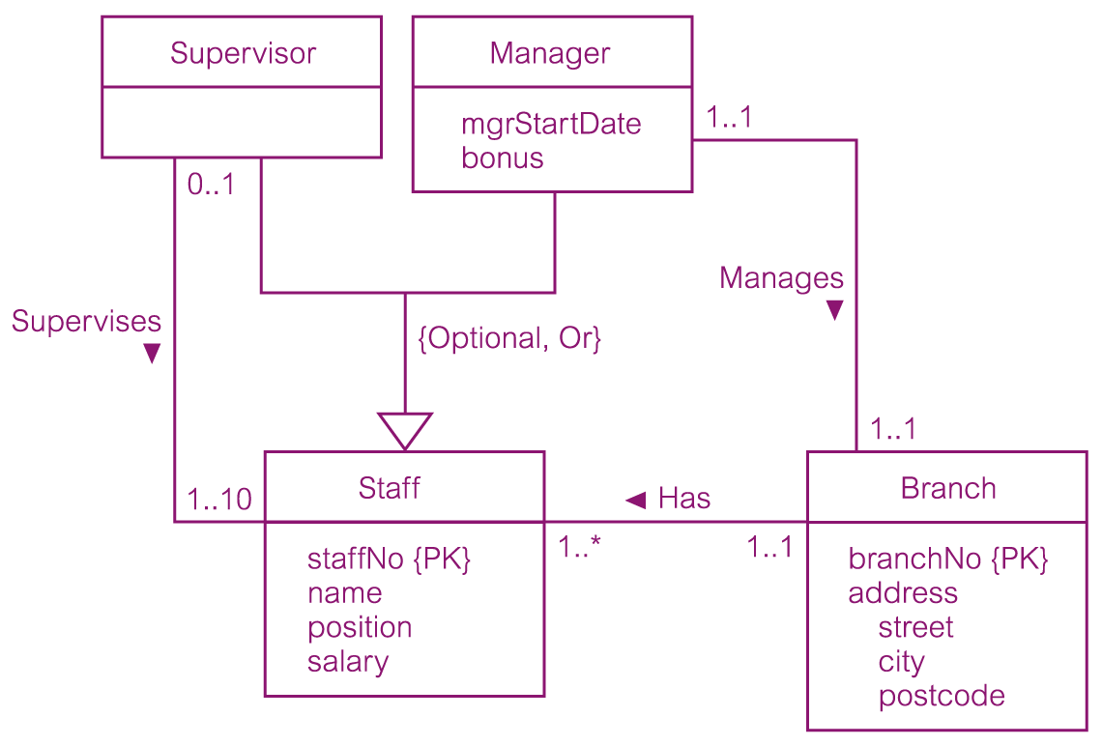
DreamHome worked example - Staff Superclass with Supervisor and Manager subclasses
Pearson Education © 2009

Slide 18
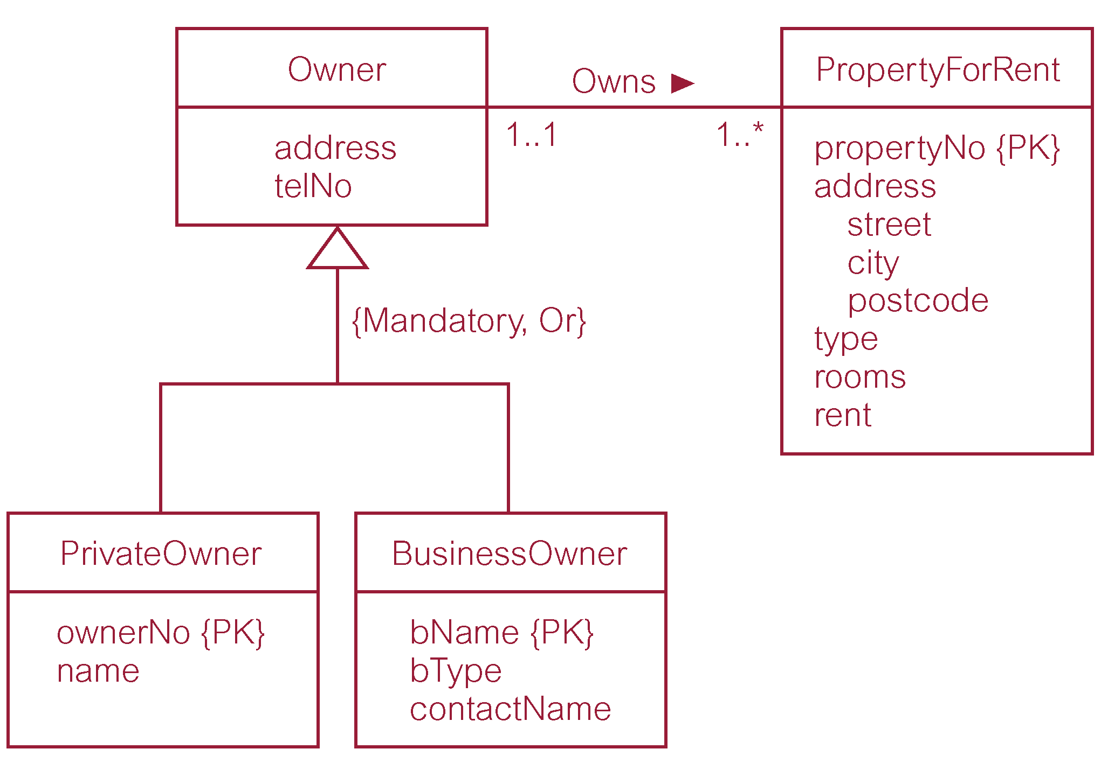
DreamHome worked example - Owner Superclass with PrivateOwner and BusinessOwner subclasses
Pearson Education © 2009

Slide 19
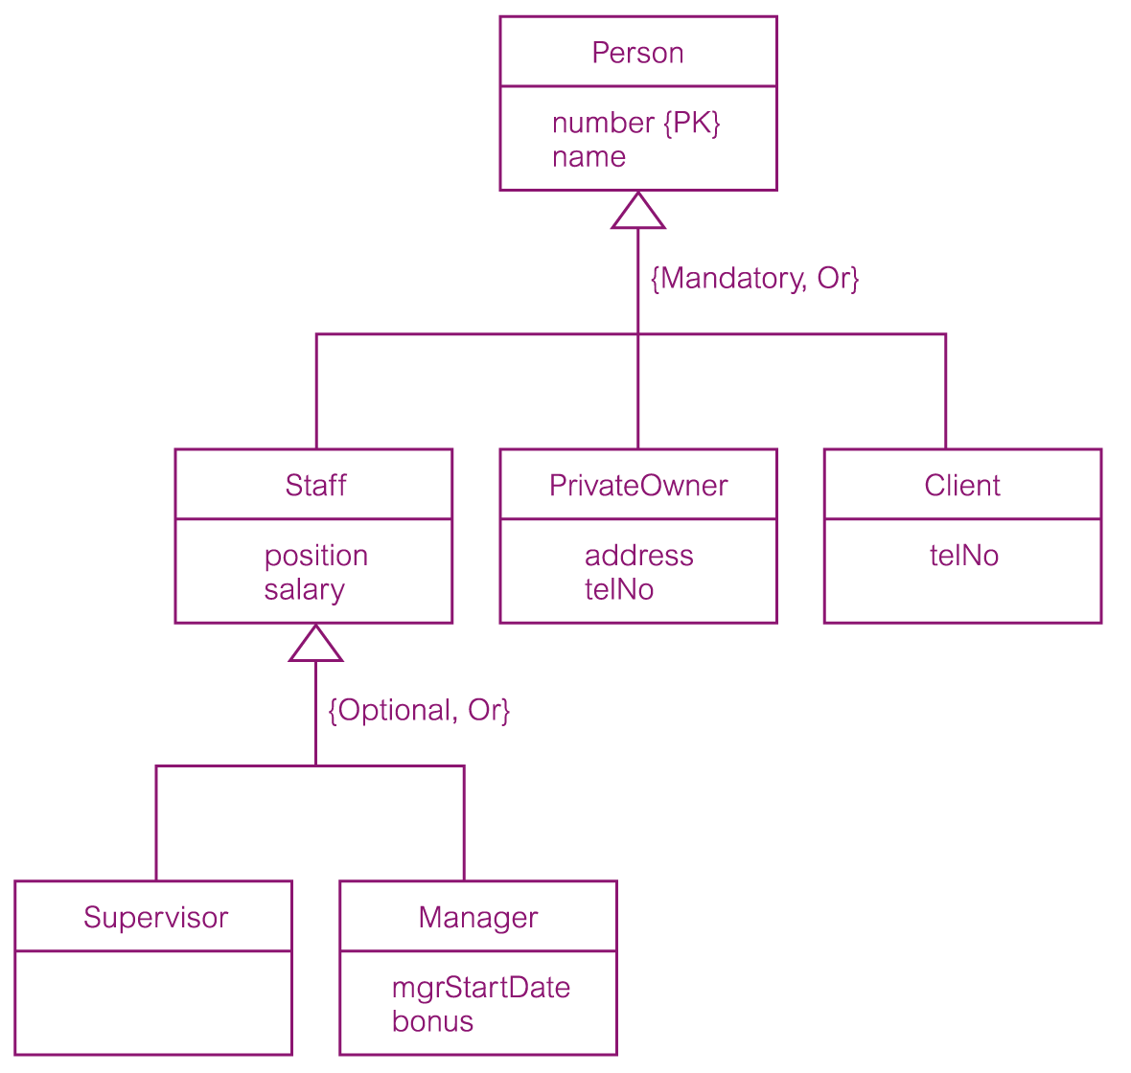
DreamHome worked example - Person superclass with Staff, PrivateOwner, and Client subclasses
Pearson Education © 2009

Slide 20
Aggregation
Represents a ‘has-a’ or ‘is-part-of’ relationship between entity types,
where one represents the ‘whole’ and the other the ‘part’.

Slide 21
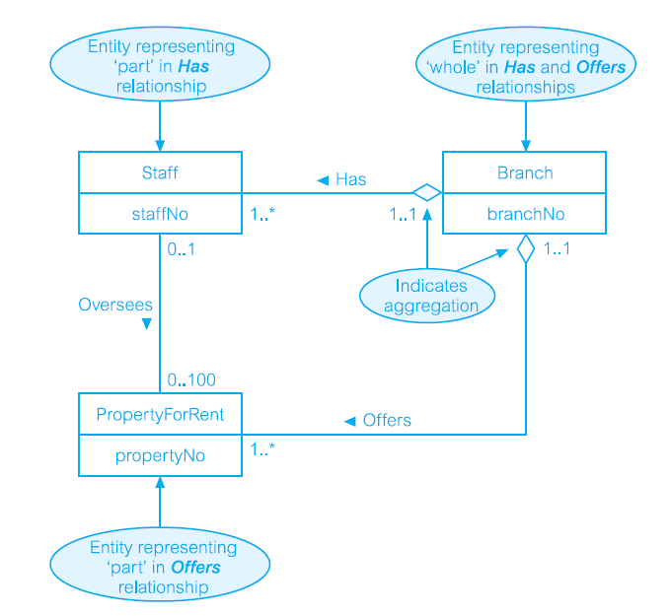

Slide 22
Composition
A specific form of aggregation that represents an association between entities, where there is a strong ownership and coincidental lifetime between the ‘whole’ and the part’.

Slide 23
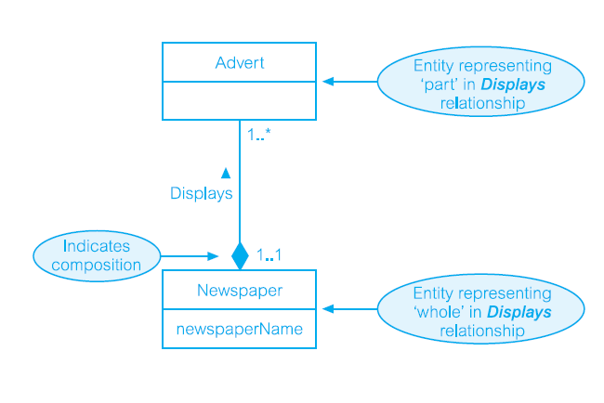

Slide 24
Practice 02
Design a database for an airline. The database must keep track of customers and their reservations, flights and their status, seat assignments on individual flights, and the schedule and routing of future flights. Your design should include an E-R diagram, a set of relational schemas, and a list of constraints, including primary-key and foreign-key constraints.

Slide 25
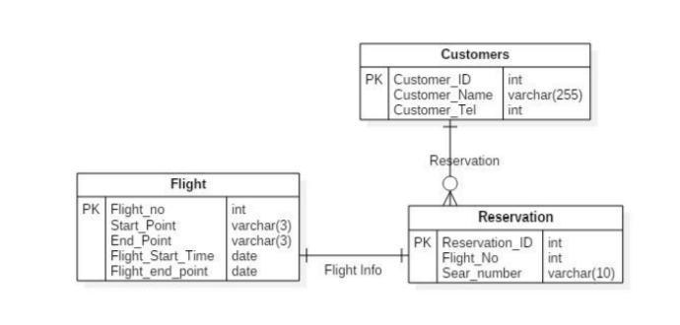

Slide 26
Design Issues

Slide 27
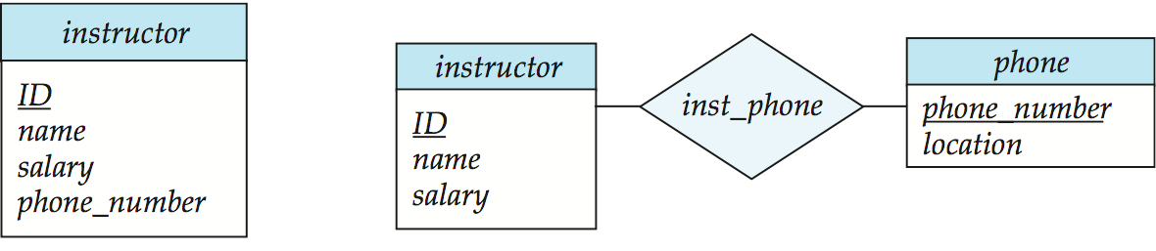
Entities vs. Attributes
Use of entity sets vs. attributes
Use of phone as an entity allows extra information about phone numbers (plus multiple phone numbers)
Notes:
27

Slide 28
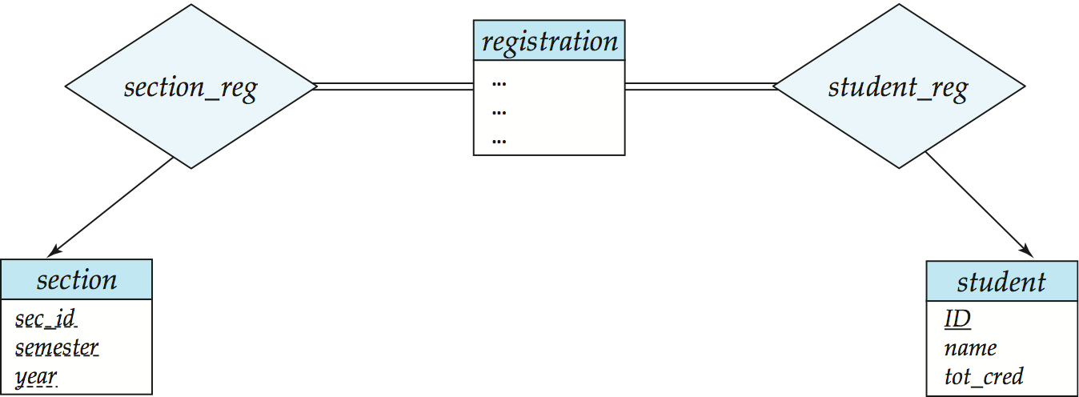
Entities vs. Relationship sets
Use of entity sets vs. relationship sets
Possible guideline is to designate a relationship set to describe an action that occurs between entities
Placement of relationship attributes
For example, attribute date as attribute of advisor or as attribute of student
Notes:
28

Slide 29
Binary Vs. Non-Binary Relationships
Although it is possible to replace any non-binary (n-ary, for n > 2) relationship set by a number of distinct binary relationship sets, a n-ary relationship set shows more clearly that several entities participate in a single relationship.
Some relationships that appear to be non-binary may be better represented using binary relationships
For example, a ternary relationship parents, relating a child to his/her father and mother, is best replaced by two binary relationships, father and mother
Using two binary relationships allows partial information (e.g., only mother being known)
But there are some relationships that are naturally non-binary
Example: proj_guide
Notes:
29

Slide 30
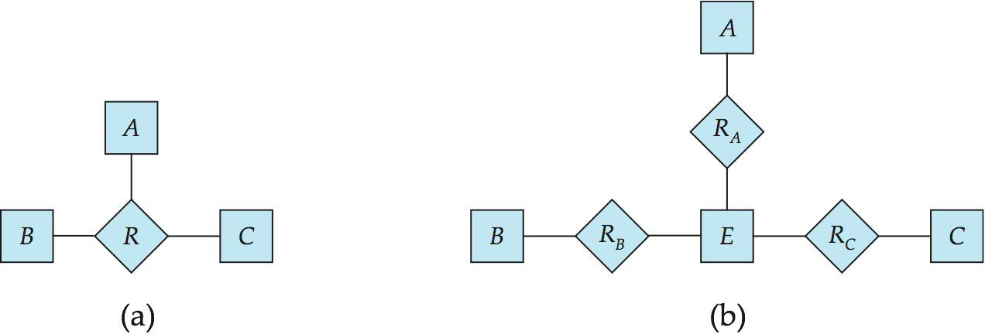
Converting Non-Binary Relationships to Binary Form
In general, any non-binary relationship can be represented using binary relationships by creating an artificial entity set.
Replace R between entity sets A, B and C by an entity set E, and three relationship sets:
1. R_{A}, relating E and A 2. R_{B}, relating E and B 3. R_{C}, relating E and C
Create an identifying attribute for E and add any attributes of R to E. For each relationship (a_{i} , b_{i} , c_{i}) in R, create:
a new entity e_{i} in the entity set E 2. add (e_{i} , a_{i} ) to R_{A}
3. add (e_{i} , b_{i} ) to R_{B} 4. add (e_{i} , c_{i} ) to R_{C}
Notes:
30

Slide 31
E-R Design Decisions
The use of an attribute or entity set to represent an object.
Whether a real-world concept is best expressed by an entity set or a relationship set.
The use of a ternary relationship versus a pair of binary relationships.
The use of a strong or weak entity set.
The use of specialization/generalization – contributes to modularity in the design.
The use of aggregation – can treat the aggregate entity set as a single unit without concern for the details of its internal structure.

Slide 32
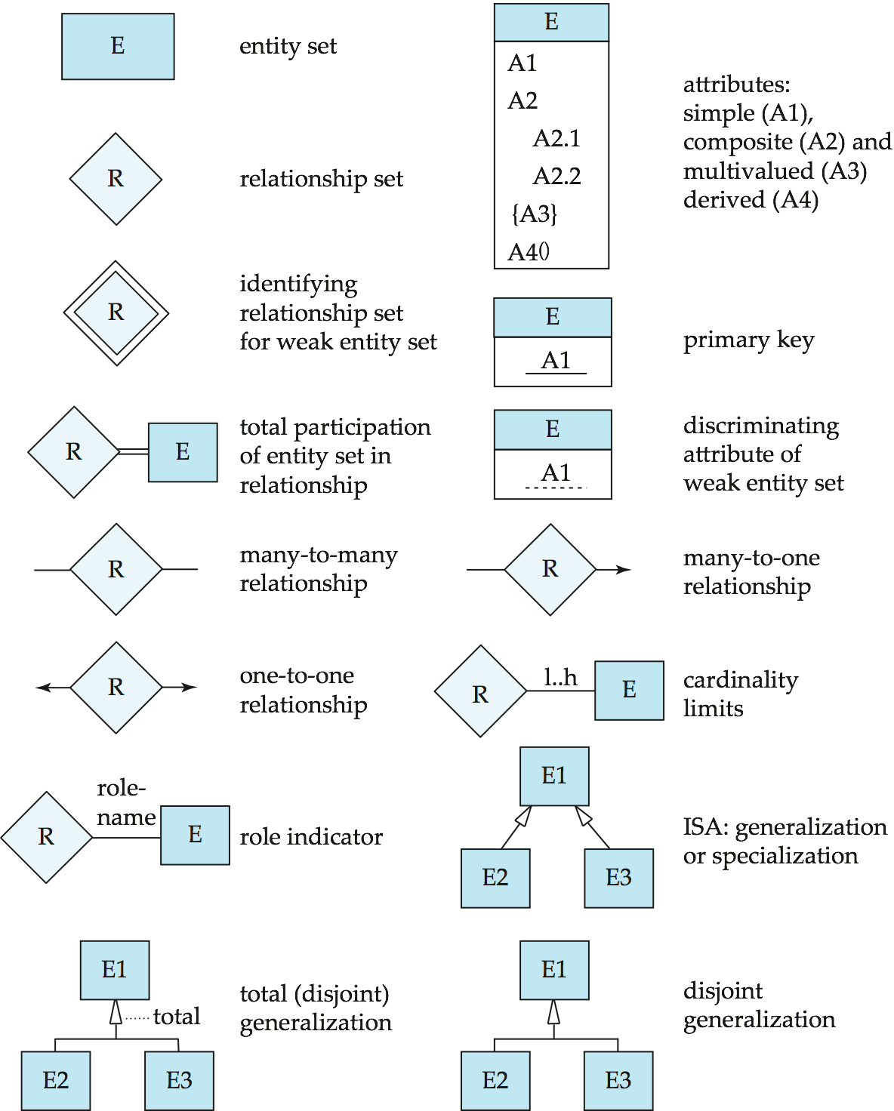
Summary of Symbols Used in E-R Notation

Slide 33
Symbols Used in E-R Notation (Cont.)

Slide 34
Suggested Reading
Chapter 12 of Database Systems: A Practical Approach to Design, Implementation, and Management by Thomas Conolly 6th Edition
Chapter 7 of Database System Concepts by Abraham Silberschatz
Download Visual Paradigm, ER Assistant based on Crows notation or any other drawing tool to complete the exercise problems. Or you can use LucidChart for online diagram Modeling.

Slide 35
References
https://www.db-book.com/db6/slide-dir/index.html
https://www.pearson.com/us/higher-education/product/Connolly-Powerpoint-Slides-for-Database-Systems
https://er-assistant.software.informer.com/
https://www.visual-paradigm.com/download/community.jsp
https://www.lucidchart.com/pages/examples/er-diagram-tool
https://db-engines.com/en/ranking

